Slide 1


Reporting service (RS)

Slide 2

Team: PRIUS
Reporting service
Dinh Thang Nguyen
Ha Vu Duy Nguyen
Huy Toan Nguyen
Van Ty Pham

Slide 3

Agenda
Overview about RS
architecture
Technology stack
Class diagram & sequence diagram
demo

Slide 4

Reporting service
Subscribes to the topic “SS_...” – scoring service
Serves the Client : Provides all values published by SS in the shape of a table - chart
Informs the user of all current Sensitivity Index values
Allows export of the listed information in CSV formatted file

Slide 5
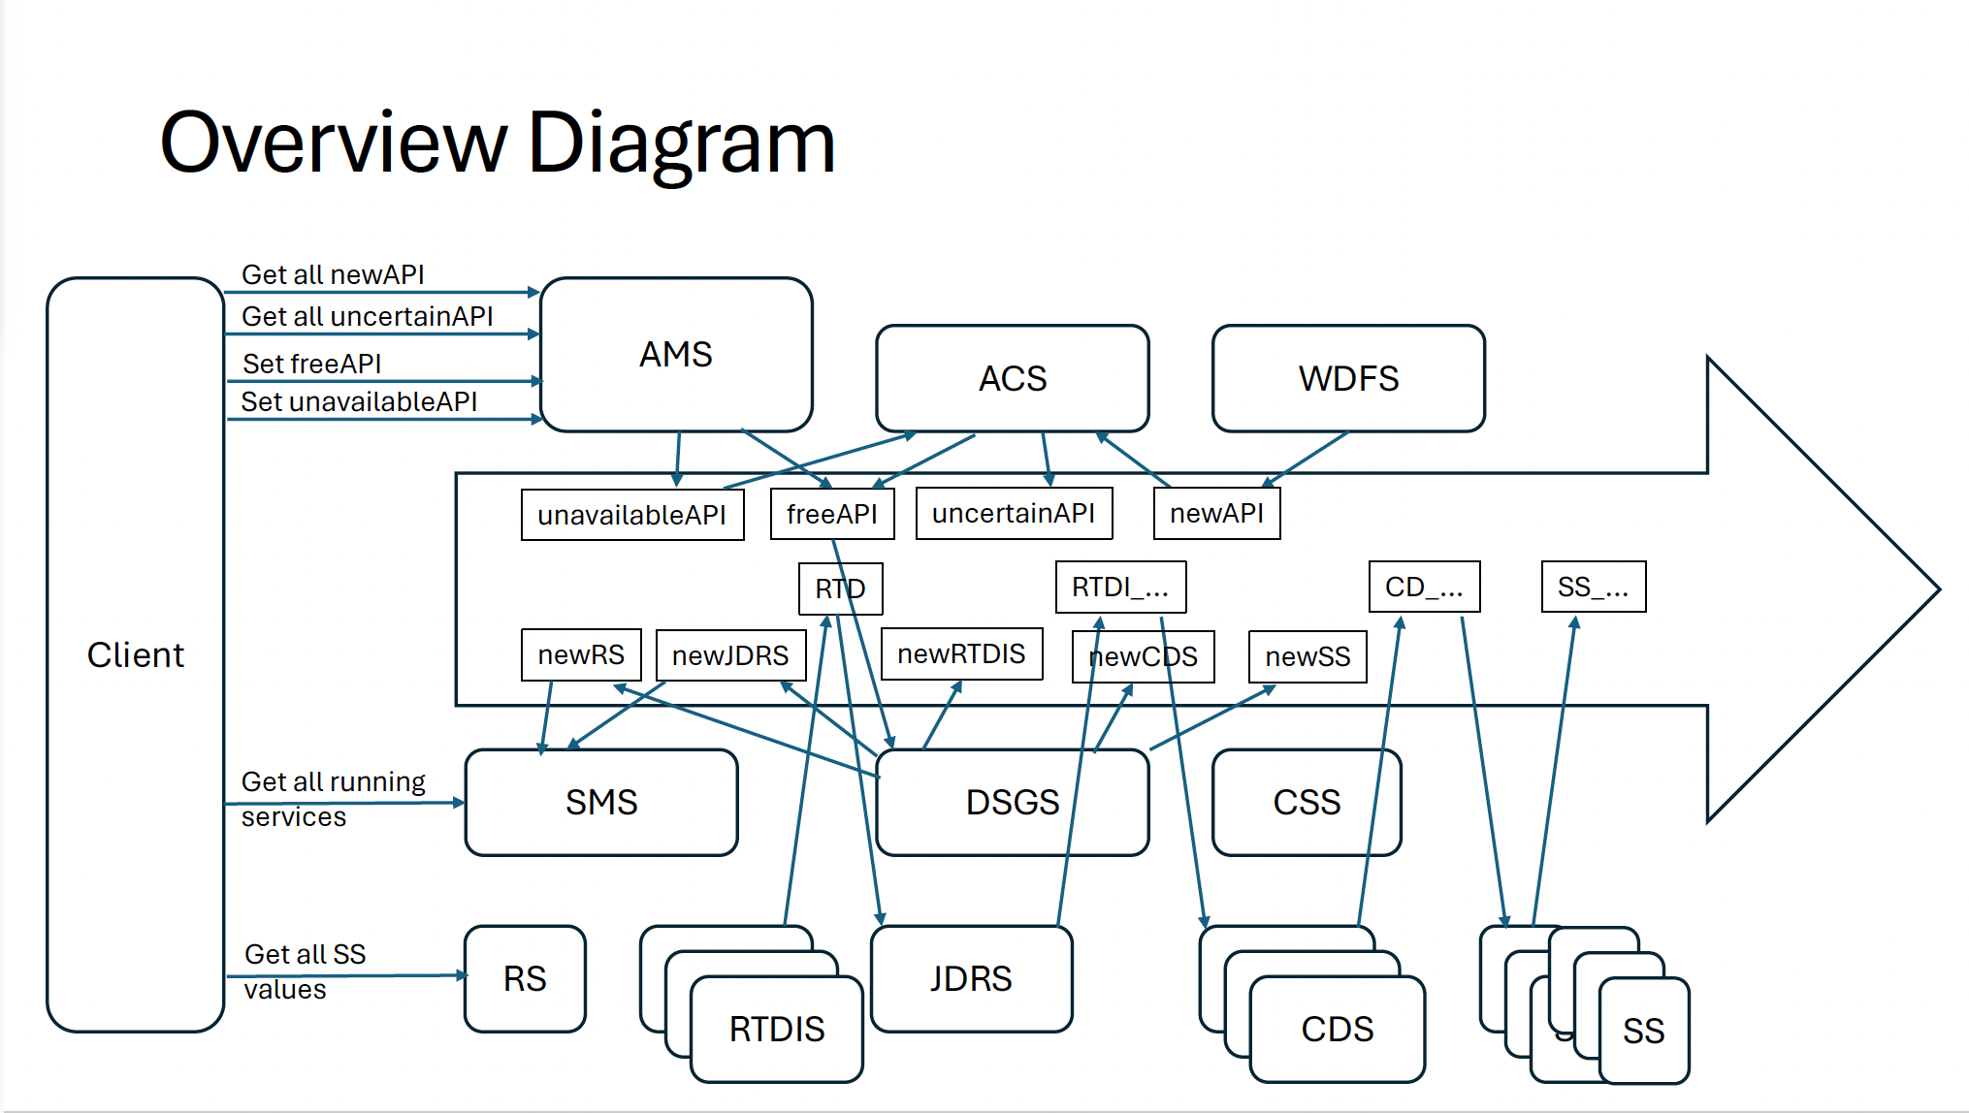
What we do in whole picture
SS_..
Web app
RS
iOS

Slide 6
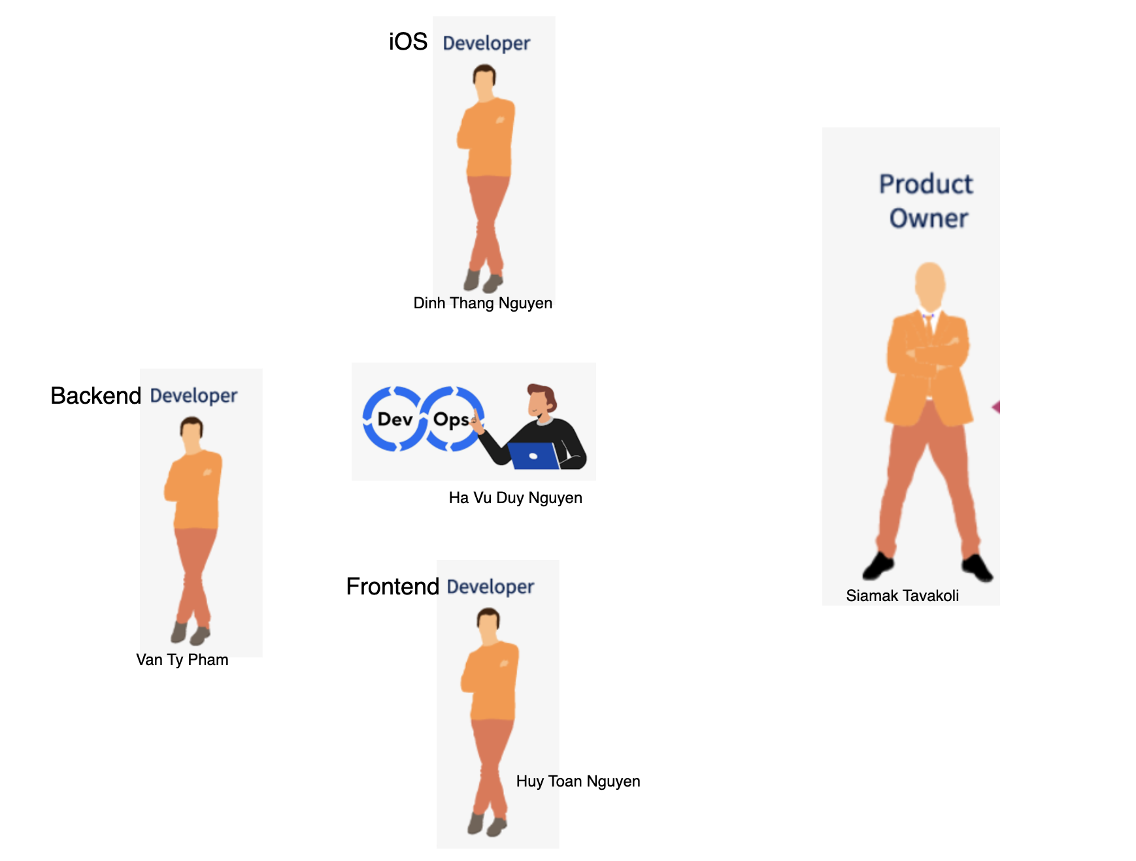
Team roles

Slide 7
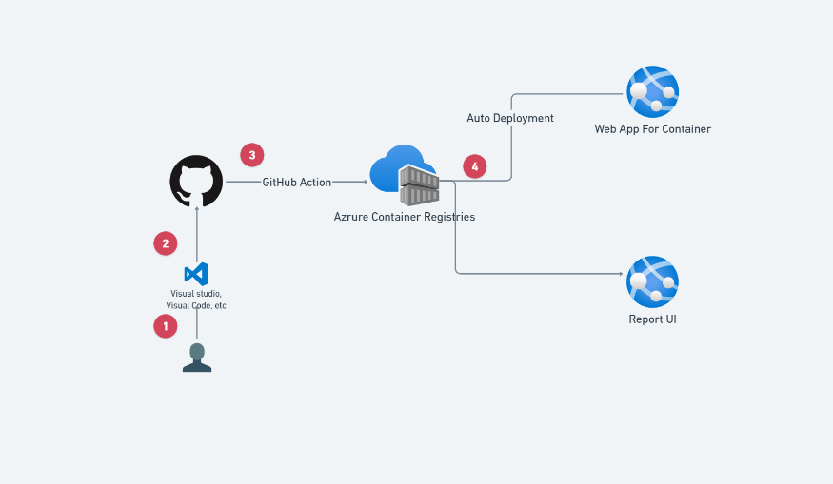
auto ci/cd

Slide 8
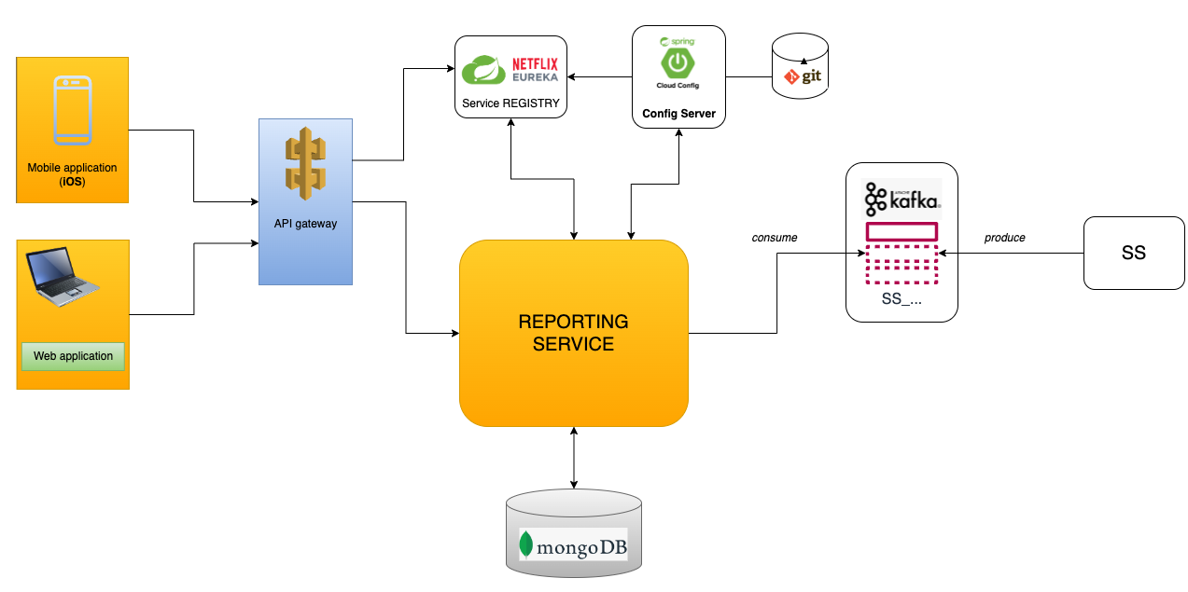
Microservice architecture

Slide 9
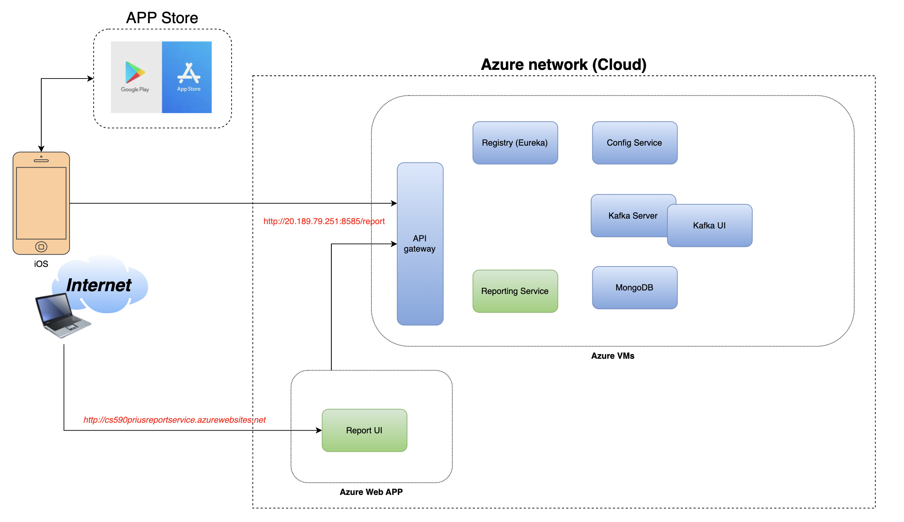
Deployment diagram

Slide 10
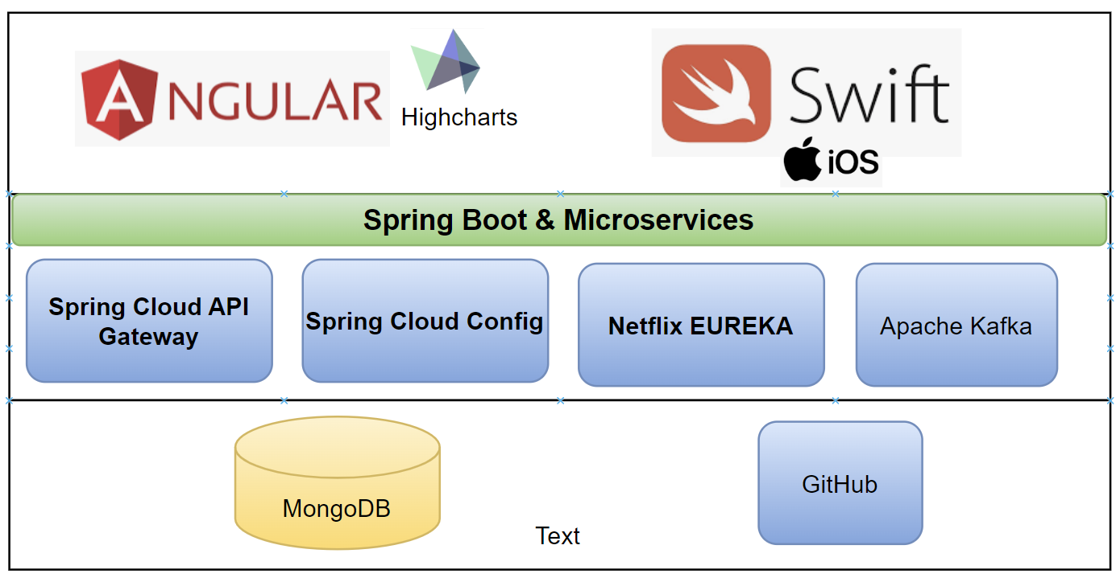
Technology stack

Slide 11
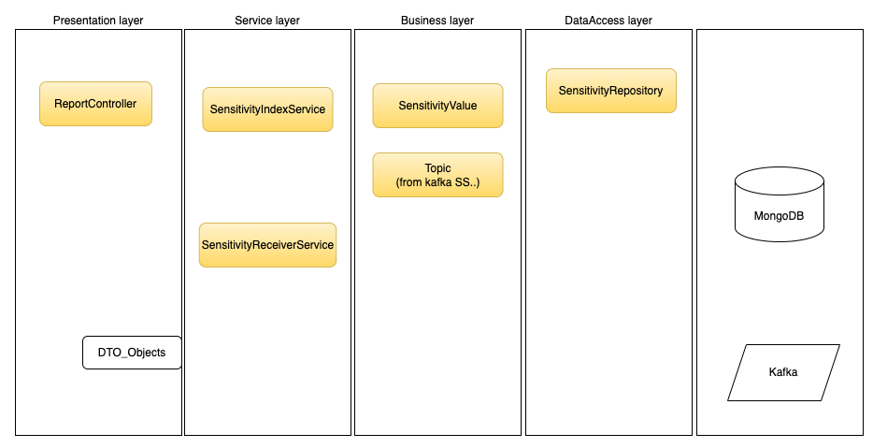
Layers in microservice - RS

Slide 12
screenshots

Slide 13
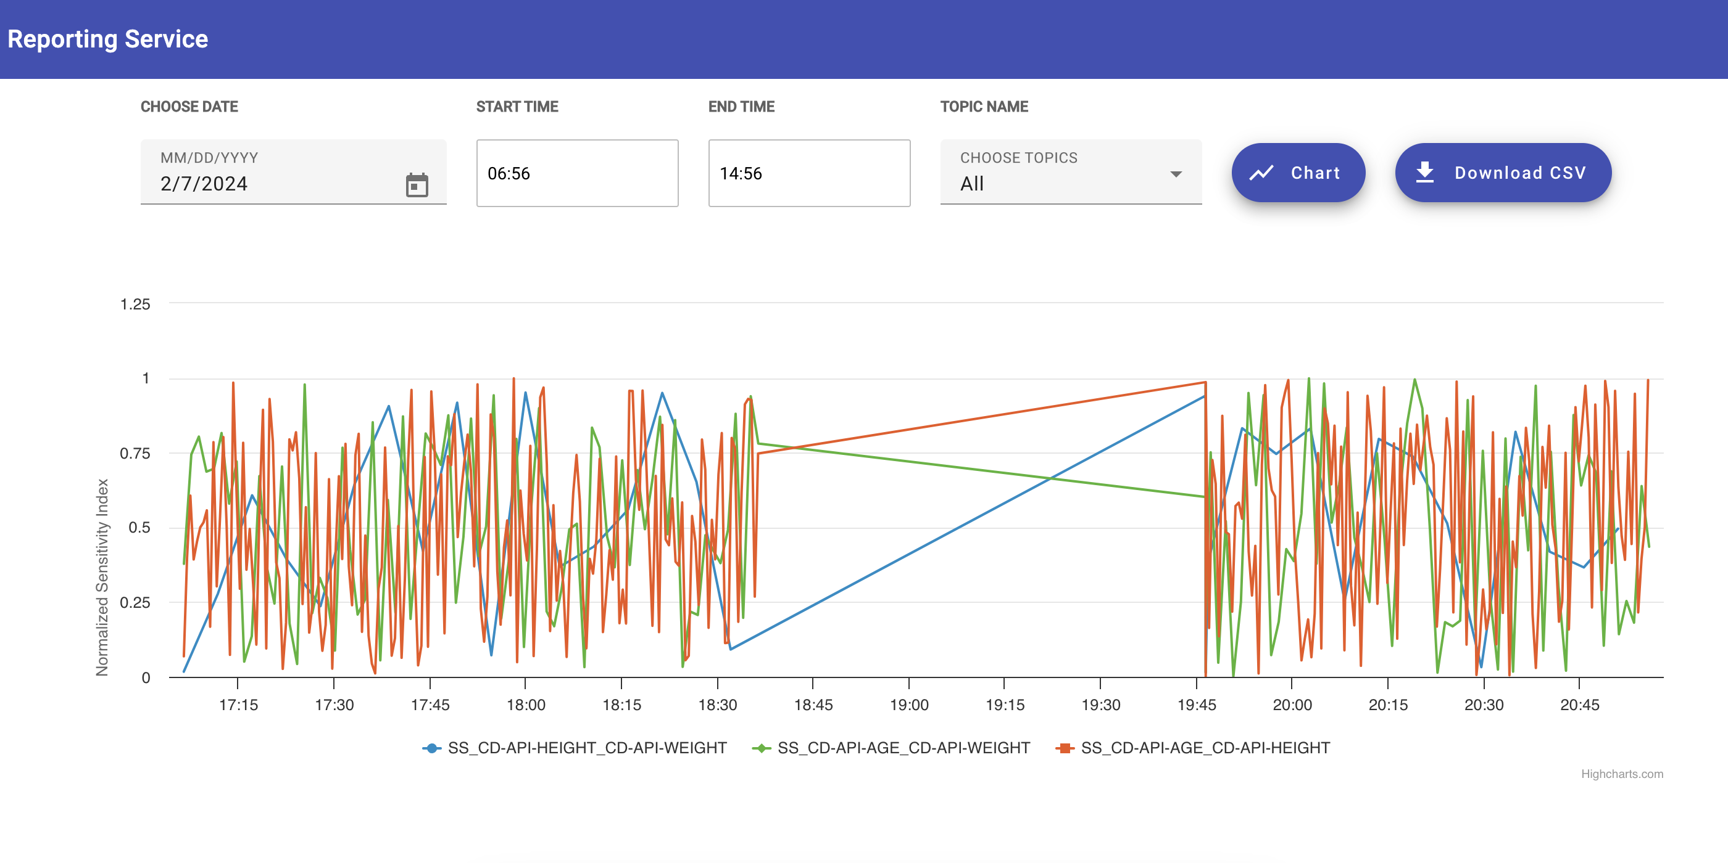
Report ui (web app)

Slide 14
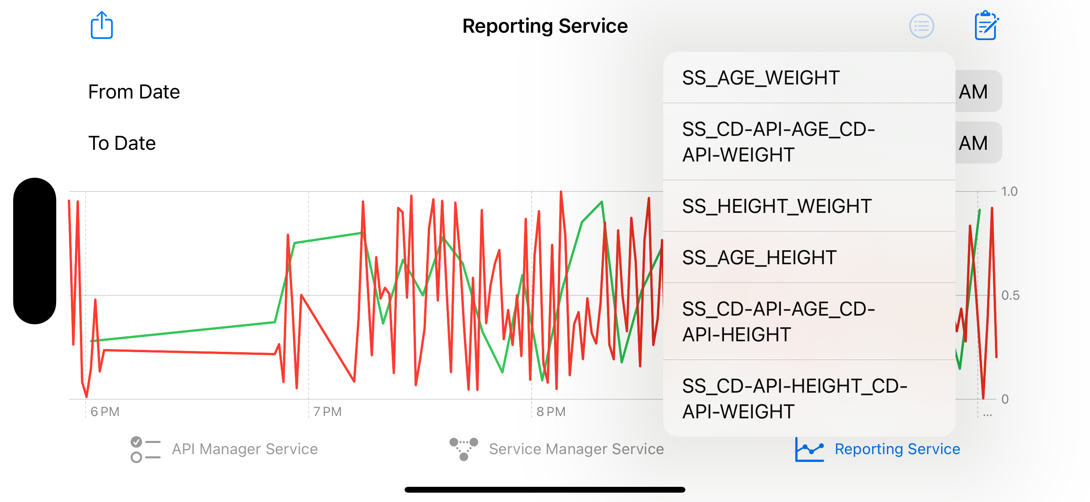
Mobile iOS app

Slide 15
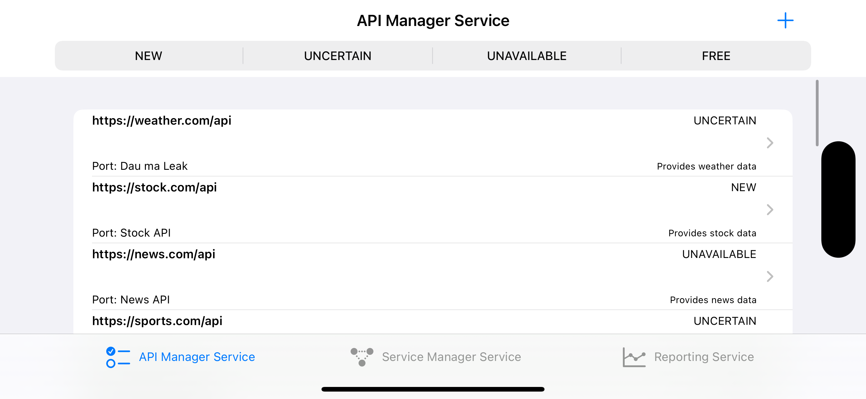
Api management ui

Slide 16
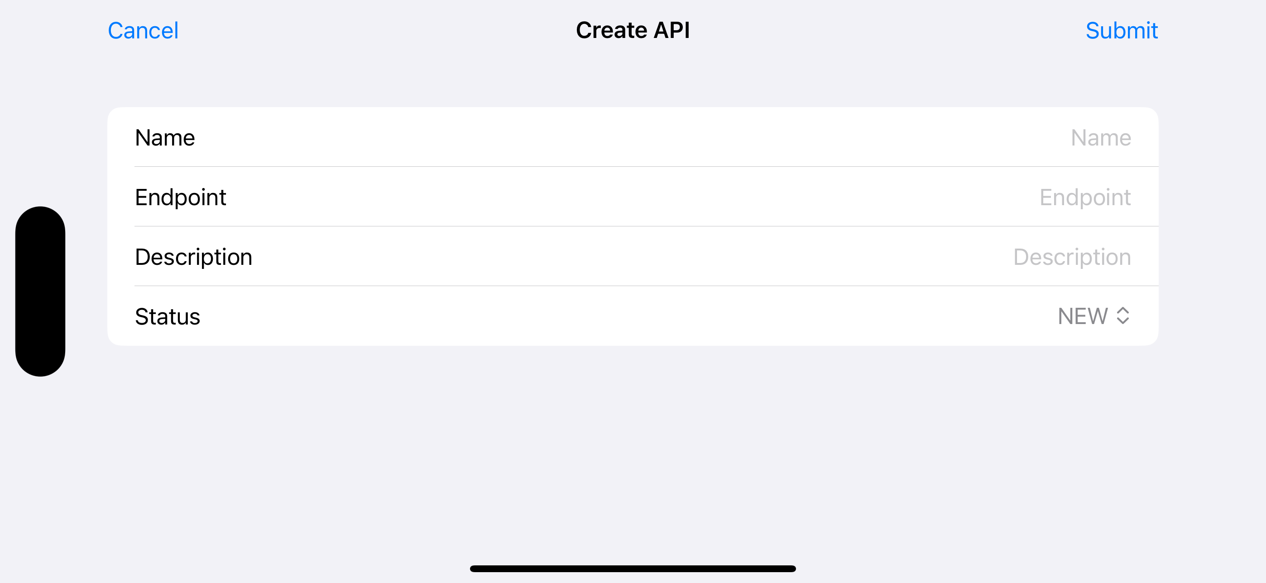
Api management ui

Slide 17
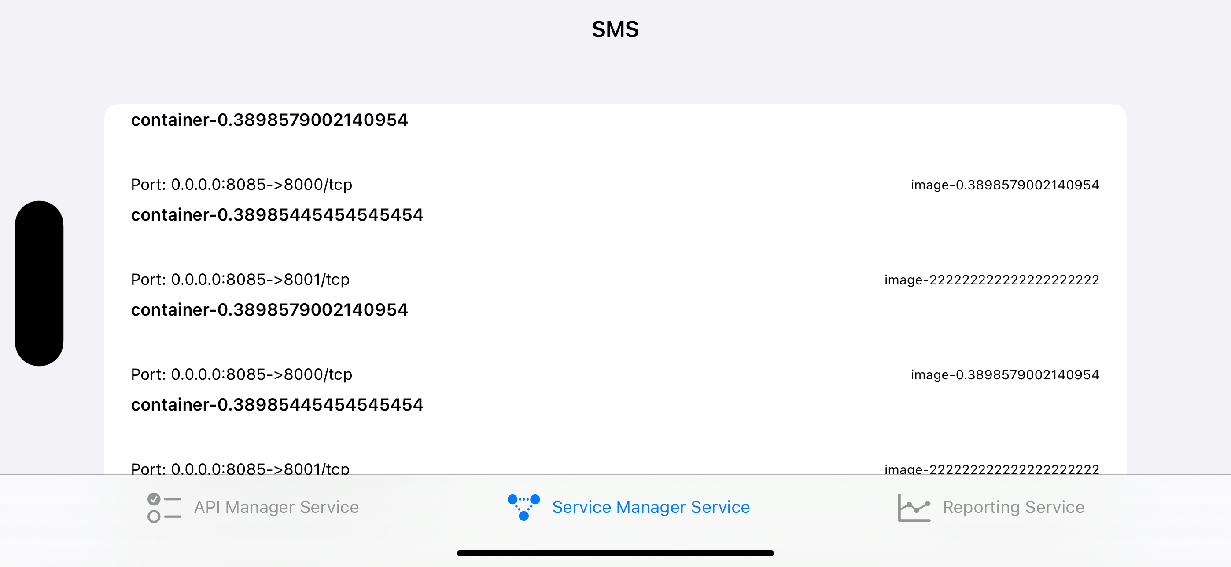
Sms ui

Slide 18

Q&A

Slide 19

Thank you!

